Slide 1
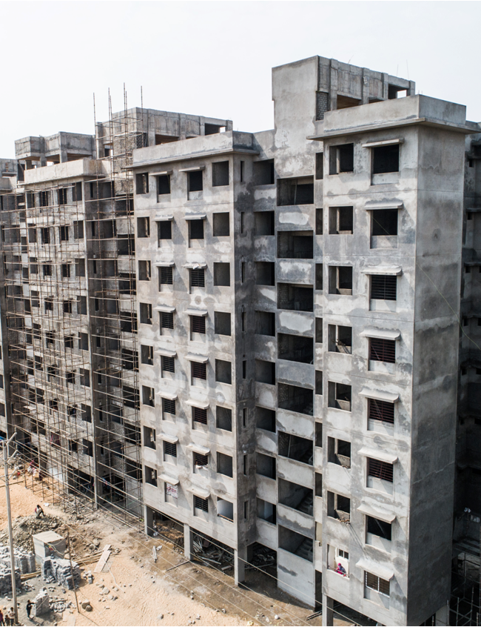
Light House Project of Indore under GHTC
Lokesh Kumar Jangid
State Mission Director, PMAY(U)
Madhya Pradesh

Slide 2
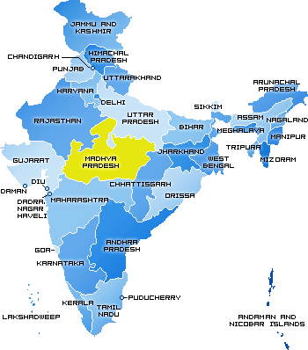
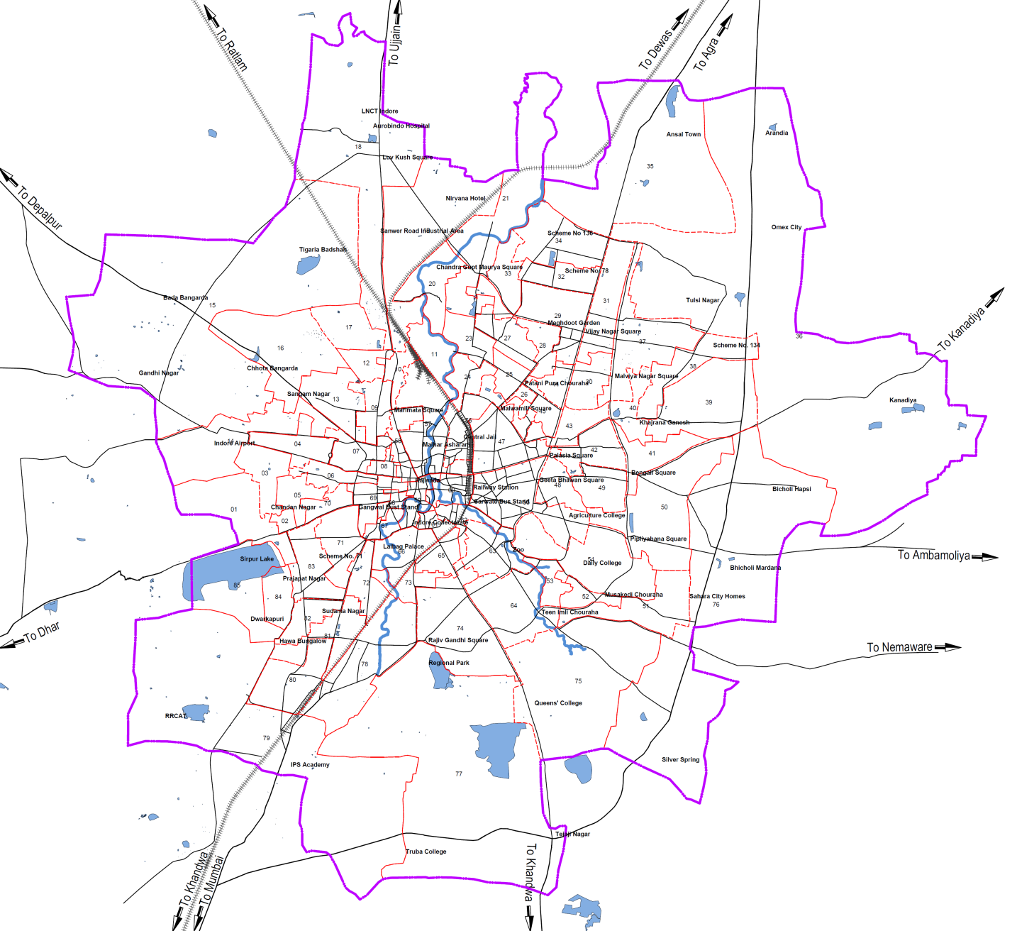
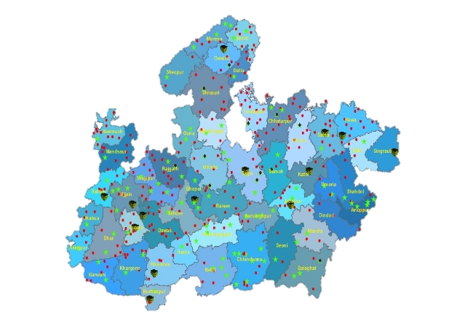
Location Details of Municipal Corporation
Proposed Site
INDORE-
Total Population | 26.45 lakhs
Planning Area | 505 sq. km.
Municipal Area | 276 sq. km.
Total No. of Slums | 646
Slum Household | 182989
Urban Poor Households | 75379

Slide 3
Salient Features of Proposed Site
S. No. | Particulars
1. | Implementing agency | Indore Municipal Corporation (IMC)
2. | Ownership of the land | Indore Municipal Corporation
3. | Size of the proposed land | 4.19 Ha
4. | Buildable Dwelling Units | 1024 Units (P+8)
5. | Availability of basic amenities | Site is linked with basic infrastructure facilities
6. | Distance from city centre | 9.58 km from railway station
7. | Site development status of the project | Vacant, even piece of land demarcated with poles by IMC and approach from 45 mt. wide master plan road through 2 lane road.
8. | Availability of facilities for factory setting | Out of 4.19 Ha land, 3.0 Ha land will be used for construction of DUs. Remaining land can be used for setting up of factory.
9. | Details of transport linkage of the project | Site surrounded by 30 mt. wide master plan road on two sides, approach from 45 mt. wide master plan road and new public transport route SR-9 proposed linking Biholi Mardana to Bada Bangarda

Slide 4
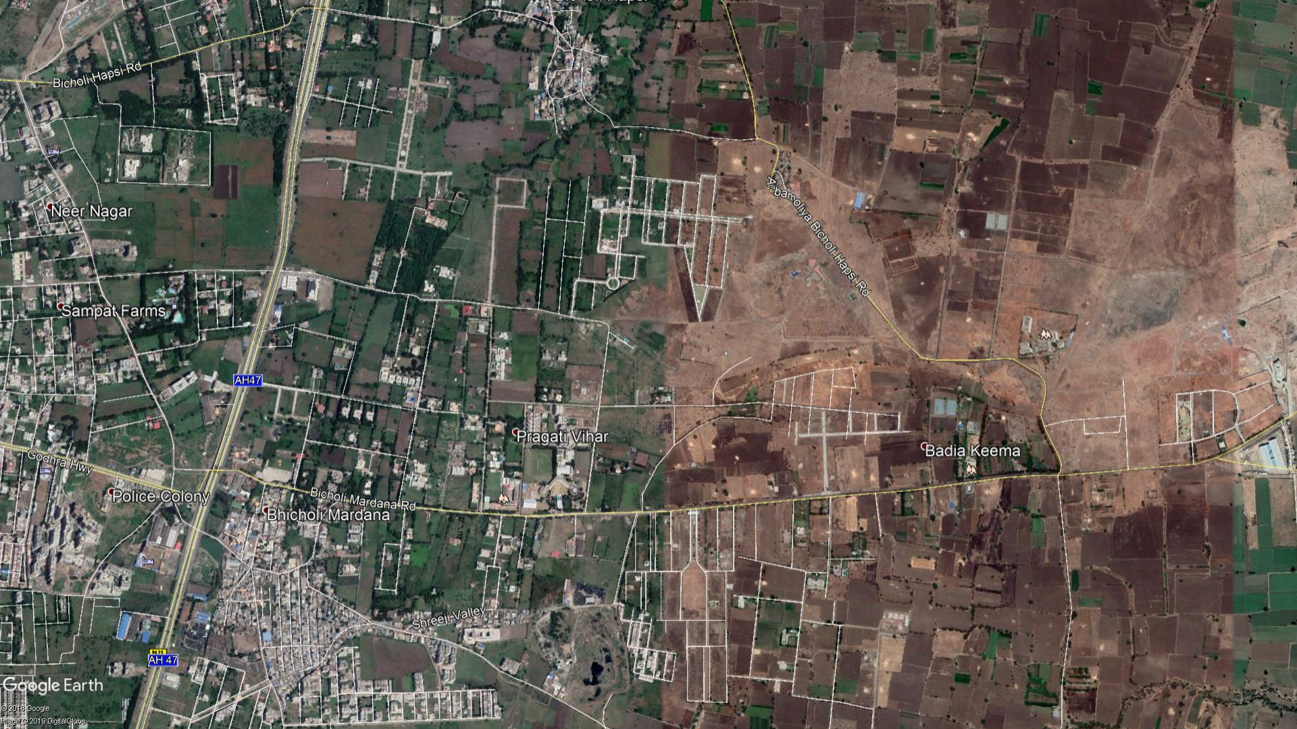
Project Site Location
Proposed 75 M Bypass
Proposed Site
30 Mts Master plan Road
IMPETUS IT Park
Towards Railway Station
Pragati Vihar
Sanghvi Academy
45 Mts Master plan Road
Vedanta Int. School
Indore By-pass (NH-3)
Sakar City

Slide 5
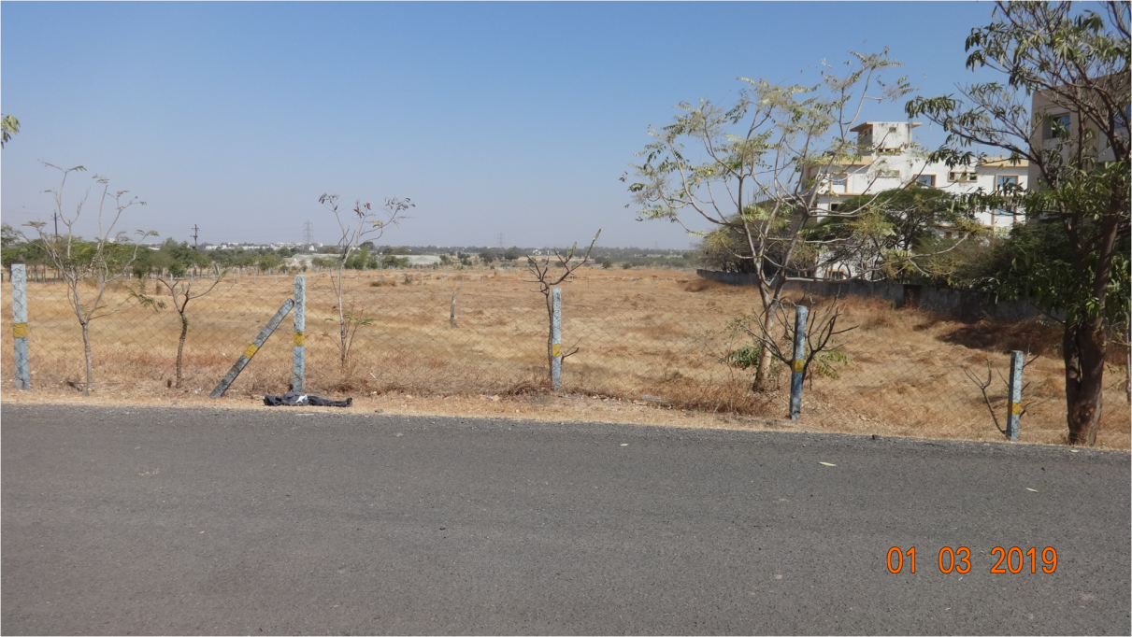
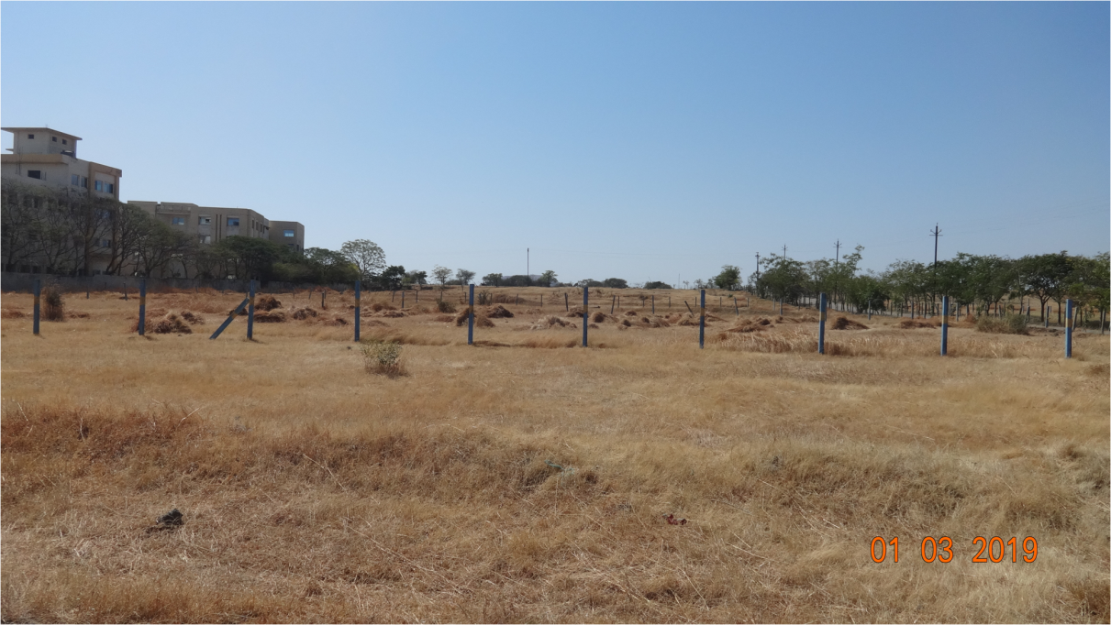
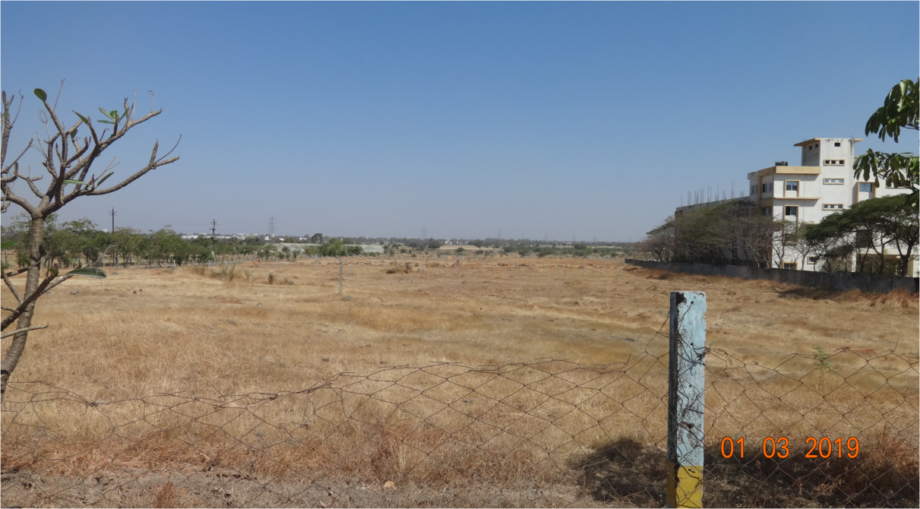
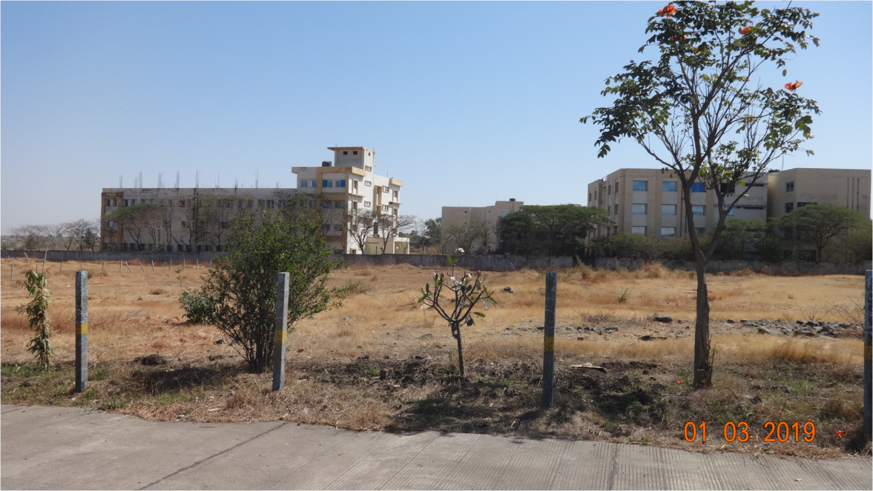
Proposed Site Photographs

Slide 6
Proposed Site Details
1. | Max. Permissible FAR/FSI | 1:2
2. | Seismic Zone | Zone II
3. | Geo Climatic Zone | Tropical Savanna (Aw)
4. | Soil Type | 1-12 Mts Rock
Statutory Approvals
5. | T &CP | Approved
6. | Building Permission | Approved

Slide 7
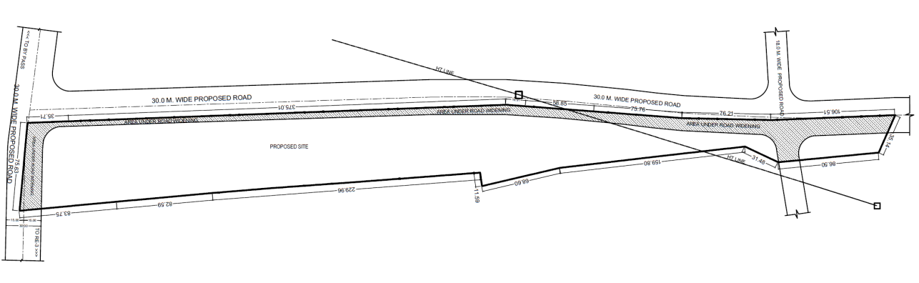
Project Site Plan

Slide 8
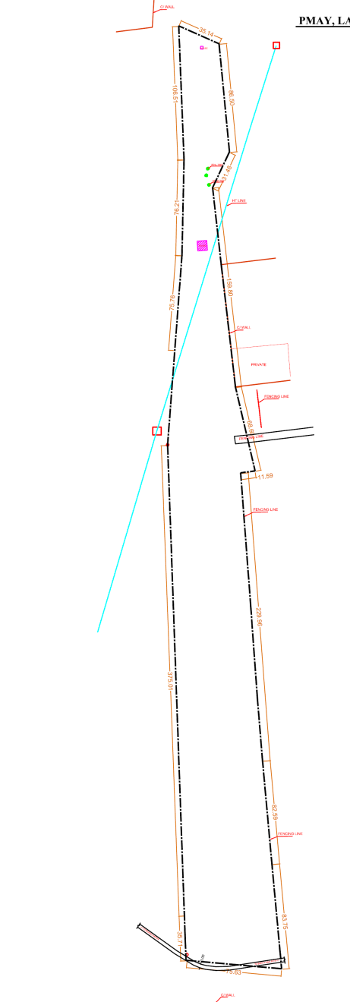
Project Site Contour Plan

Slide 9
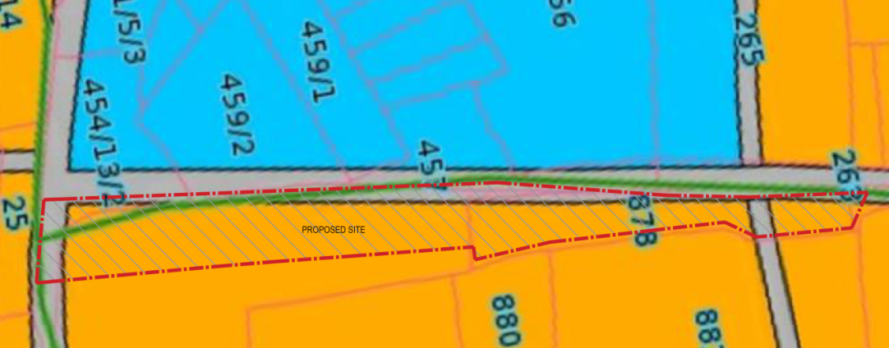
Project Site Land Use Plan
Legend
Commercial
Residential

Slide 10
Project Site Tentative Layout Plan

Slide 11
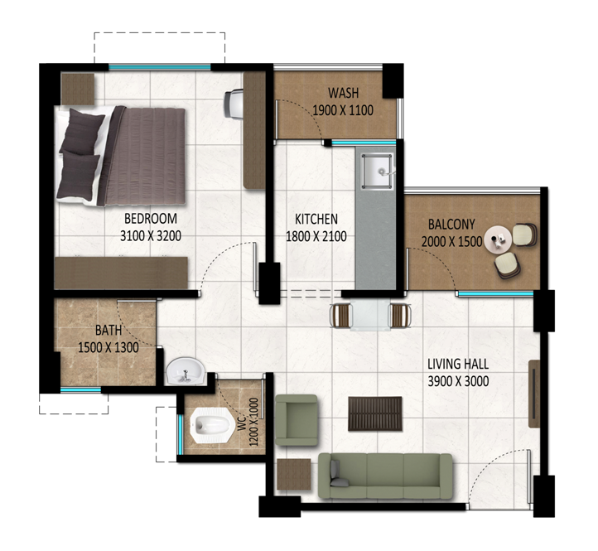
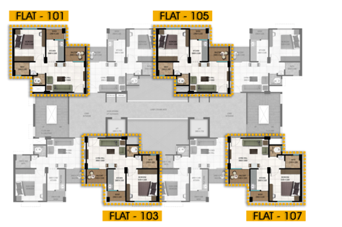
Typical DU and Floor Plan
1- BHK Unit- 1 Bedroom, 1 Living Room, Kitchen, Separate Bath and Toilet, Balcony and Wash Area
Carpet Area - 32.05 sq. m.
(344.98 sq. ft.)
Salable Area - 53.23 sq. m.
(572.23 sq. ft.)
Typical Floor Plan for P+8 Block

Slide 12
Thank You…

